Slide 1
PREDICTING TRAM DELAYS VELOCITIES BASED ON WEATHER
Wojciech kretowicz
Karol pysiak
Mateusz szysz

Slide 2
Short recap
The goal is to:
predict in a real-time Warsaw tram delays velocities and
monitor them
The data sources are Warszawskie Dane (timetables and current position of trams) and OpenWeatherMap (weather prognoses)

Slide 3
Data sources - recap
Timetables are rarely updated and contain static information describing how the tram traffic should look like
Tram positions in the API are updated every few seconds, this includes:
longitude and latitude
timestamp
line, vehicle identifier and brigade
Current weather data is updated every 2 minutes and contains many parameters regarding weather condition
Weather forecasts are updated every 3 hours and contain the same parameters as a current weather

Slide 4
Updates to milestone 4
Reinventing the project: from delays to velocity
Adding more stream processing
Developing a streaming model
Adding more visualizations
Restructuring the architecture

Slide 5
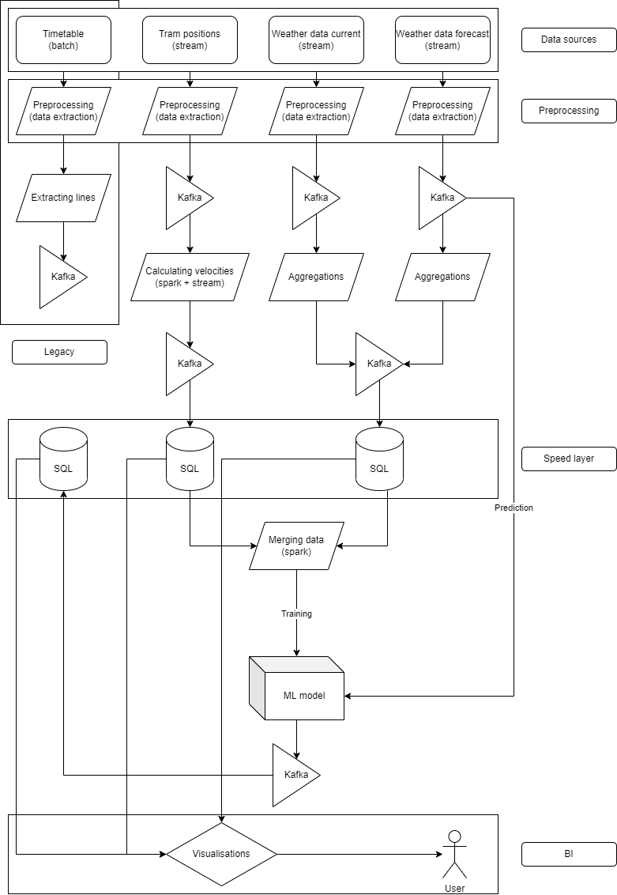
Architecture

Slide 6
Problems with Warsaw Open Data
Single message about tram does not contain any information about the direction nor about previous/next stop
Timetable has a complex structure:
Bus stops are grouped by "busstopId"
Particular stop in bus group is identified by "busstopNr"
Each bus stop group contains 1 to 6 different stops
There is no information about the direction of line except for the next stop name which is not usefull because is not compatible with "busstopId" and "busstopNr"

Slide 7
Our solution Part I – extracting lines (legacy)
We sort all entries by "time"
We group all entries by "line", "busstopId", "busstopNr"
For each group we number consecutive entries
Entries across different groups with the same number constitute a single line in a single direction preserving their order

Slide 8
Our solution part II – approximation of delays (legacy)
For each message about tram we find 4 closest stops (these are grouped in two bus stop groups each with two actual stops)
For these 4 stops we calculate time discrepancies and we find iteration that achieves minimum absolute time discrepancy
For these 4 stops within best iteration we select 2 stops with minimum absolute time discrepancy and we calculate an average of delays

Slide 9
Calculating delays in a stream is impossible in spark
In order to calculate the approximation of the delay, we must refer to the same row in a stream many times
It is impossible to do that in a stream in spark
Thus, we had to change slightly our target to velocity, which can be calculated as part of a stream
Delays still can be calculated, but only in a batch manner – this is a legacy part of our system

Slide 10
Our solution part III – Velocity
For each pair (line, brigade) we find in a given time window (i.e. 1 minute) maximum and minimum longitude and latitude
Then the travelled distance is calculated
We calculate the velocity in degrees / hour
Convertion to km / hour

Slide 11
Architecture solution for velocity
Velocity for each vehicle is calculated in a continuous manner, as a stream
Thus, we use Spark to enhance the tram position stream
Spark then merges information about trams with the current weather
This is used as a training data to the model
Weather forecasts as a stream are then passed as an input to the already trained model
Predictions come out as a stream and land in the SQL database

Slide 12
Architecture solution for VELOCITIES MODEL
Model is updated once a day
Predictions are made in the streaming fashion, when weather forecasts data arrives
Every velocity prediction is streamed to the speed layer
The model uses features:
temp, pressure, humidity, visibility, wind, cloud, rain, snow, pop
dayofweek, minuteofday, line

Slide 13
Architecture solution for ADDITIONAL WEATHER DATA
When we receive the weather forecasts and current weather we push the data to the speed layer for users to look up
Everything is done in the streaming fashion
Transformed data is stored in the sql database ready to analyse

Slide 14
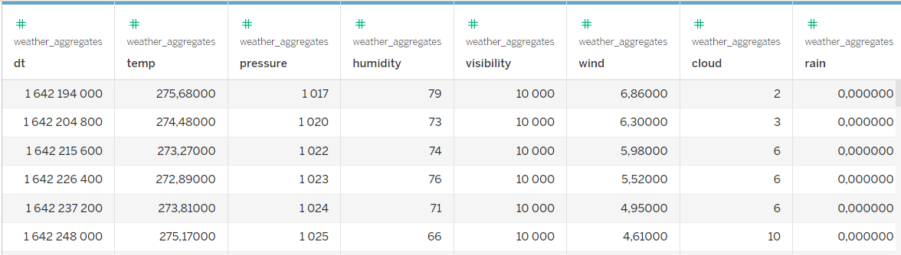
SPeed LAYER

Slide 15
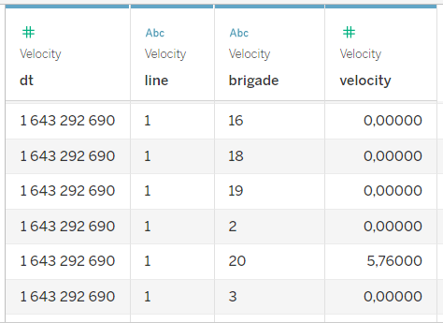

Slide 16
Visualisations
Visualisations are created from data in the SQL databases in the speed layer
These are made with Tableau, but equally they could be done in any BI or visualisation tool
Tableau allows to easily establish a live connection

Slide 17
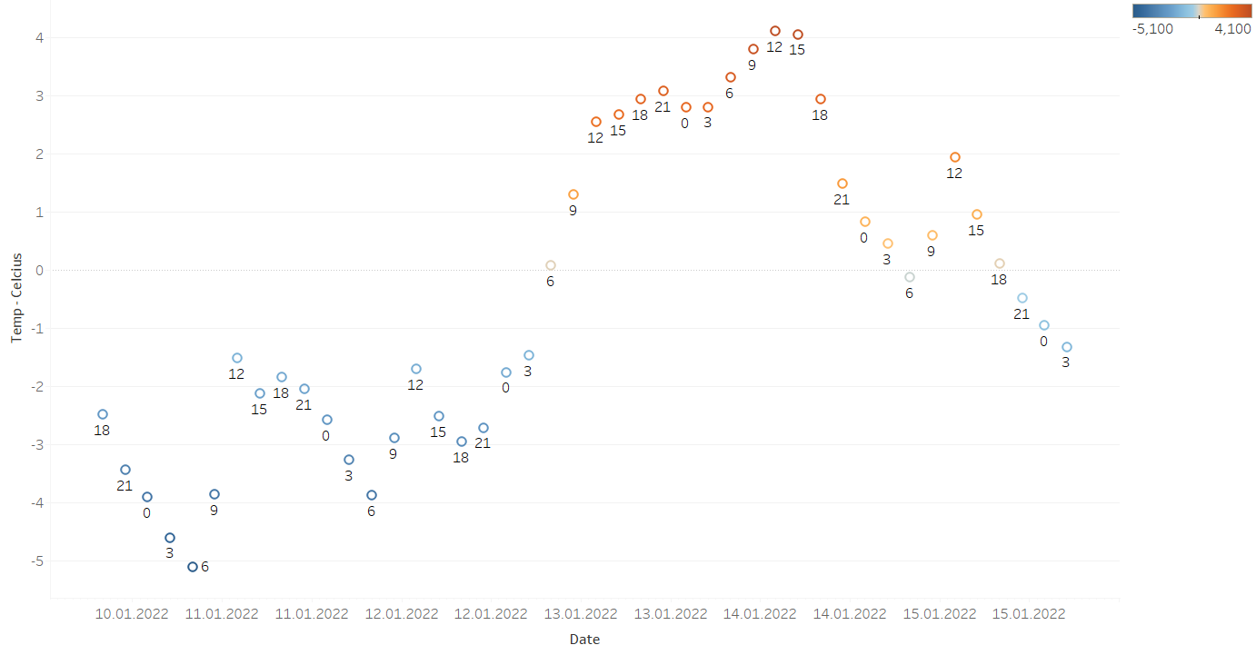

Slide 18
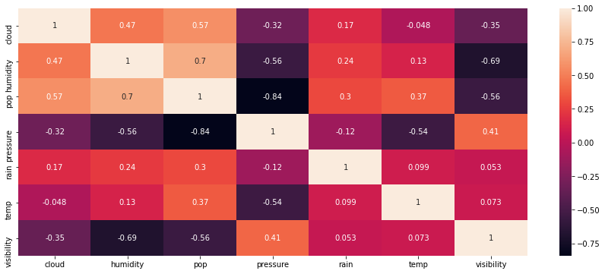

Slide 19
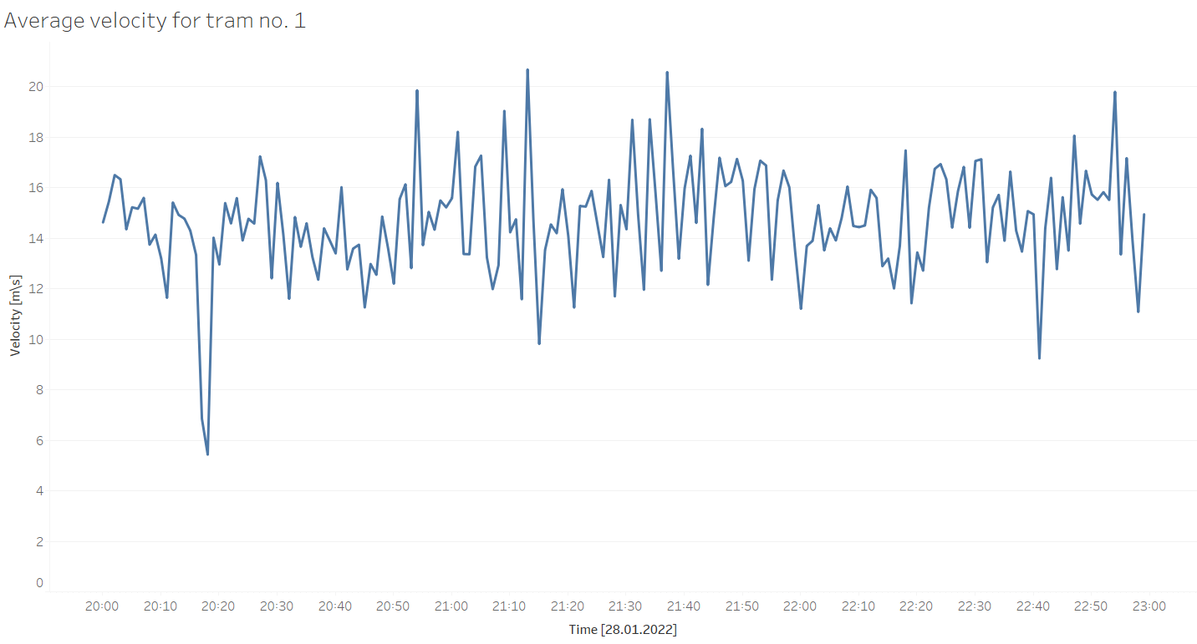

Slide 20
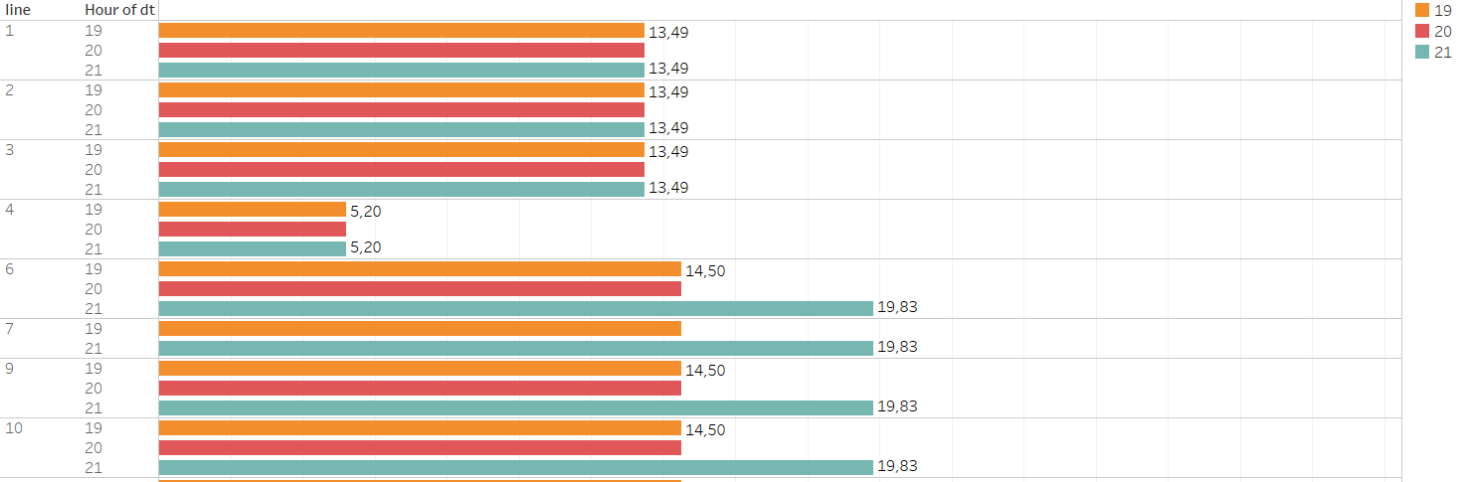

Slide 21
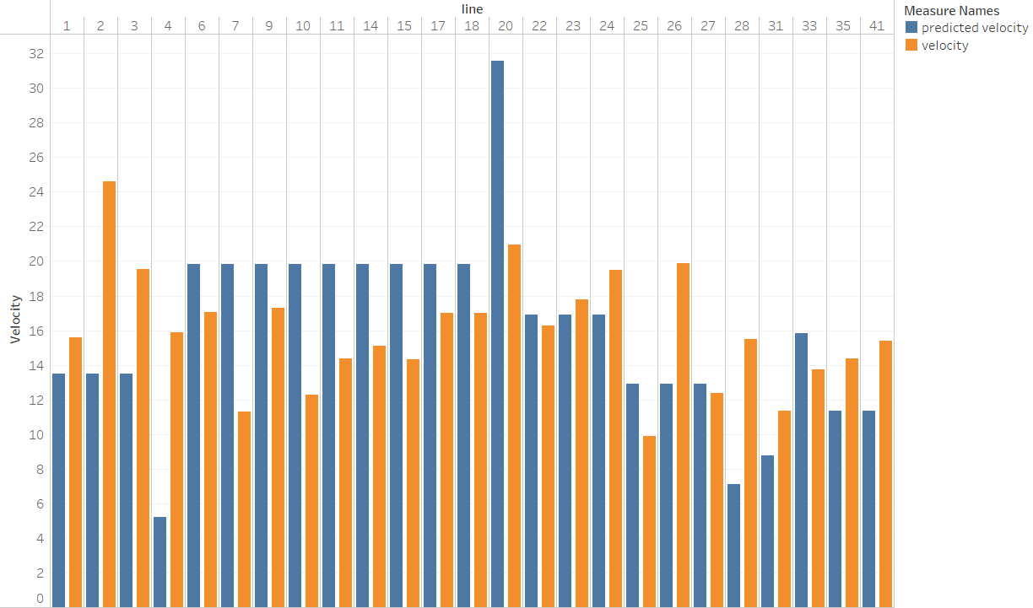

Slide 22
Impact of the project on the society
Threats:
The velocities are only approximations
Weather and time are not the only factors that may impact the velocities
Users may use it as the only source of information for planning their journeys
Opportunities:
Some regularities in velocities may be recognized, so it may be helpful in identifying bottlenecks
Deviations from standard values of velocities may suggest delays or congestion
Our users can have an insight about upfront deviations of velocity, Google Maps show only current conditions

Slide 23
Thank you for your attention

